Slide 1
Launching Tridion Docs Version 15
Joe Pairman, Chip Gettinger, and Fraser Doig

Slide 2
Get more done, keeping quality

Slide 3
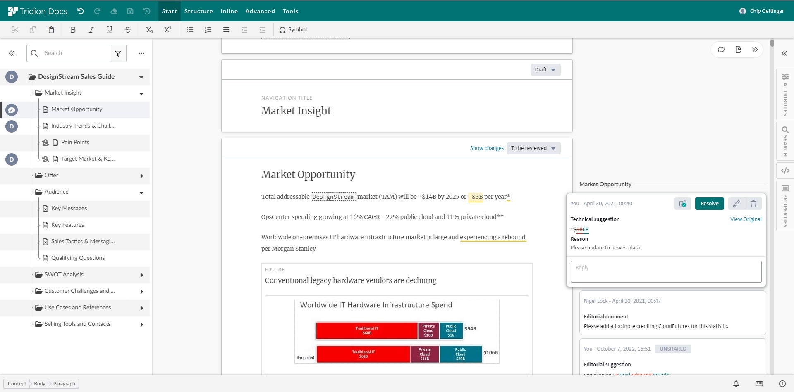
Collective Spaces
More intuitive and efficient navigation
UI improvements
Table of contents on the left and can be hidden for more space
In-context comment ‘bubbles’
Commenting
‘Save and share’ button
Configure “reason for change” as optional
Document history
Timeline on right hand side
Select revision dates for changes you want to see
Notes:
Draft Space and Review Space have received significant enhancements to the layout and navigation, making it more intuitive and contextual for authors and reviewers.
Table of contents now sits on the left-hand side, which is easier to read and click through.
Feedback ‘bubbles’ on the right-hand side highlight review suggestions, feedback, and other comments.
More options for comment sharing with ‘save and share’ button.
Consolidate ‘resolved’ and ‘unresolved’ changes in a single view.

Slide 4


All-new Organize Space
Greater usability and productivity
New user experience
Based on Graphene design system
Filter, sort and make changes to content on one page
New toolbar for advanced capabilities
More intuitive settings
More granular permissions
New tabs for easy navigation
Improved search
Configure, filter and sort
Search custom metadata too
Extensible
Add buttons, menus and panels via configuration
Notes:
The Content Manager Web Client is now the all-new ‘Organize Space’, with a fresh, intuitive UI consistent with the look and feel of other RWS platforms. This re-design has brought with it a more streamlined user experience, enabling your content teams to be even more productive.
Greater usability for technical and non-technical users.
Familiar UI creates a consistent look and feel, easier to navigate.
Improved search makes it faster and easier to find what you need.
More granular permissions enable users to focus on only the most important, relevant tasks.

Slide 5
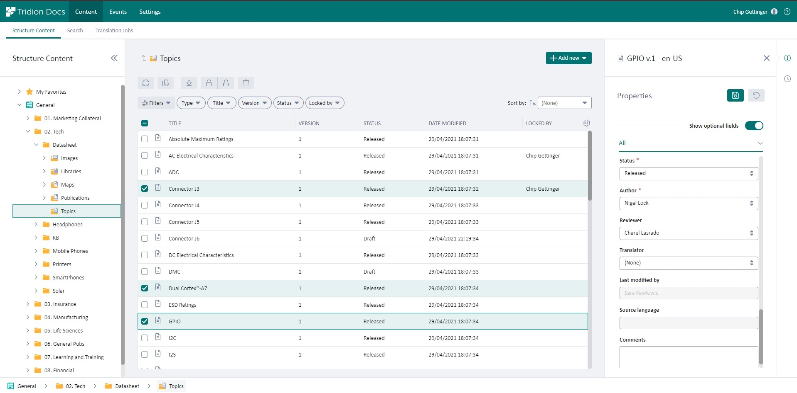
All-new Organize Space
Greater usability and productivity
Notes:
The Content Manager Web Client is now the all-new ‘Organize Space’, with a fresh, intuitive UI consistent with the look and feel of other RWS platforms. This re-design has brought with it a more streamlined user experience, enabling your content teams to be even more productive.
Greater usability for technical and non-technical users.
Familiar UI creates a consistent look and feel, easier to navigate.
Improved search makes it faster and easier to find what you need.
More granular permissions enable users to focus on only the most important, relevant tasks.

Slide 6
Gain confidence in security and performance

Slide 7

Modern authentication, greater security and governance
Easier to own and manage
OpenID Connect
Lightweight, easier to implement, JSON-based
Designed for web, has wide support:​
multi-platform, mobile devices
Ready for multi-factor authentication
Modern codebase
Updated libraries
Stay compliant with latest security standards
More secure, supportable and productive
Notes:
Security and governance
Modernization
This new release increases the security of your system, as well as making it accessible to more users on multiple platforms and mobile.
Modern authentication, via OpenID Connect.
Gives you the ability to enable two-factor authentication (2FA), if your identify provider is compatible.
Improved stability and security of the platform.

Slide 8



Platform updates in Tridion Docs 15
Tridion Docs 15 supports:
oXygen 25
XMetal 17
Windows Server 2022
Notes:
Oxygen can use latest, just accept prompt.
XMetal 6, haha. Win 95?

Slide 9
Demo

Slide 10
Guide end users to reach their goals

Slide 11

Build web experiences to meet your users' goals
Tridion DXD (headless delivery)
is now easier to use for Tridion Docs developers
Deliver Tridion Docs content at scale, across many channels, with less code to write
Harness low-code multichannel delivery
A single GraphQL request can bring back a topic and all its metadata in JSON
DXD now works better with
client-side caching (best practice)
DXD also works better with no client-side cache
Notes:
Tridion Docs 15 makes headless content more accessible for developers, enabling you to deliver personalized content, faceted navigation, and contextual guidance for a great digital experience. It will now be much easier to create exceptional digital experiences using:
Rich semantic modelling – powered by proper CCMS.
Taxonomy space
Smart tagging
Semantic search

Slide 12
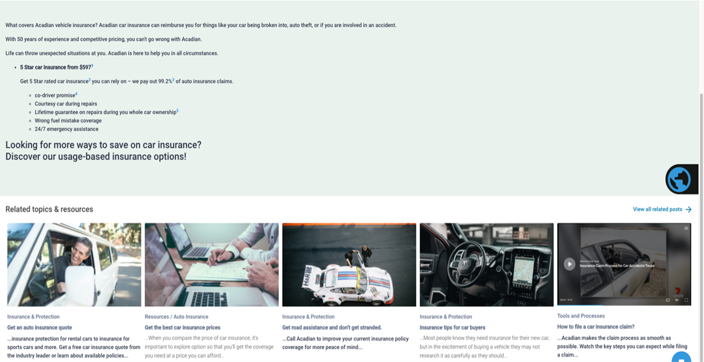
DXD creates targeted recommendations for users
Powered by Semantic AI:
Users receive tips / suggestions for the next step in their journey
Taxonomies relate content and generate automatic recommendations
Features
Configure concept schemes and boost relative weights
Use existing document footprint to drive the recommendations
Notes:
Smart content recommendation service.
Acknowledging the fact that implementing semantic AI can be quite time consuming, Tridion Docs 15 comes with features that allow to use search APIs to make recommendations using the existing content by quickly deploying taxonomy and allowing to configure concept schemes and boost relative weights. This way you can achieve full filtering of results using existing search criteria. Other useful features include using editorial search for concepts and smart tagging item metadata. These features shorten your journey towards implementing semantic AI.

Slide 13
Looking ahead

Slide 14

Making Tridion Docs easier to own
“Cloud” techniques help all our customers
Bringing publication
and project functionality
from desktop tools to web
Configuring in database, not files,
for easier upgrades and adjustments
Formalizing plugin architecture for extensions
Notes:
Not just consolidate config but move it. Of course, DITA-OT needs thought. Thinking through.​

Slide 15
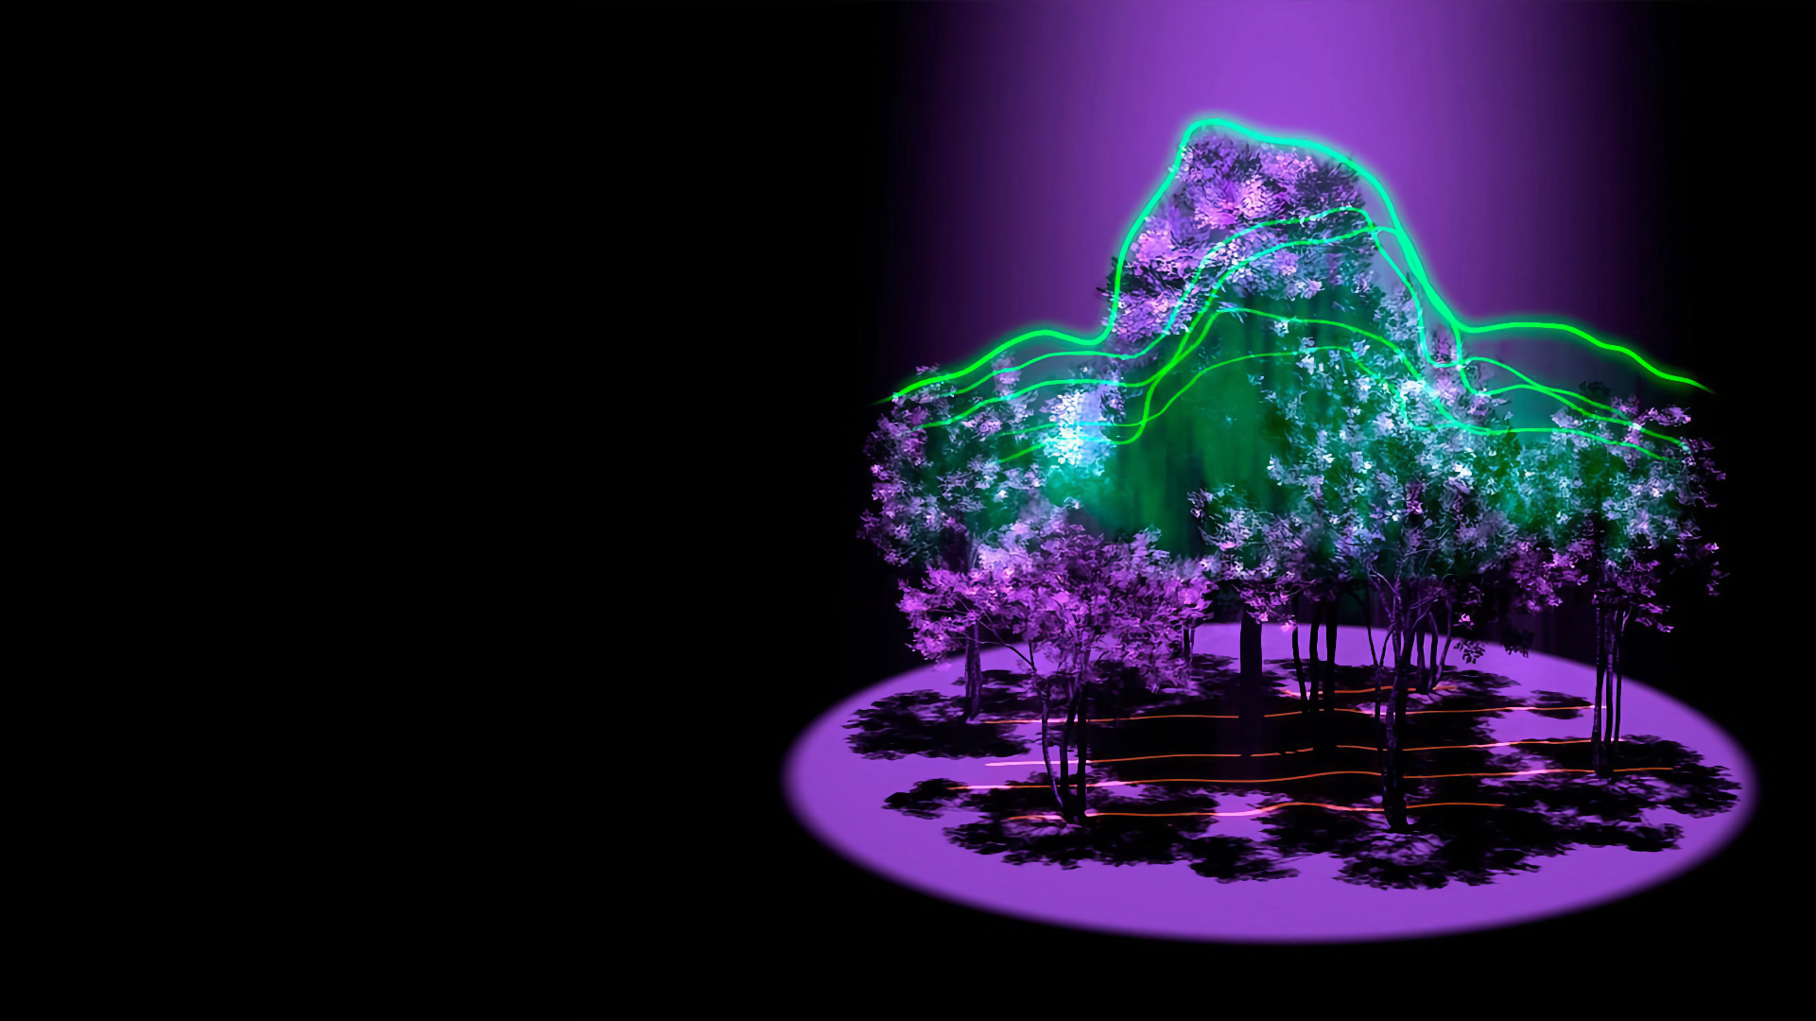
Bringing enterprise data to content
Users experience content as disconnected from the rest of your organization
Teams waste effort on aligning content accurately with product and enterprise data
Content is still an island, for reasons that are good but unsustainable
Digital transformations have made data accurate, accessible, and productized
We’ll map domain data to human content
End users will be able to dialog with our
info via AI and explore the domain directly
Product work covers all areas:
Authoring, pub management, delivery
Image from NASA Goddard Space Flight Center
Notes:
We have done the mapping in the past, e.g. for conditions, but the way we will do is more to hang projects on, drive reuse, and power intelligent delivery too.

Slide 16
Next steps:
Tridion Docs 15 due out by July; Contact RWS Professional Services or your account manager to discuss upgrading!

Slide 17
Q&A

