Slide 1
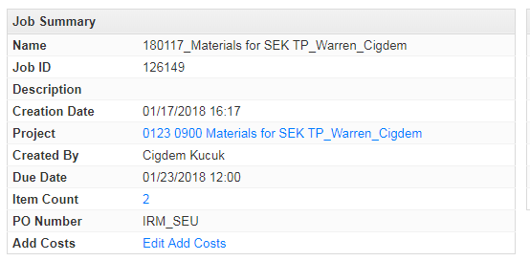
It could be great and timesaving if we could have a function that showed us the file names when we hover over the item count number.

