Slide 1
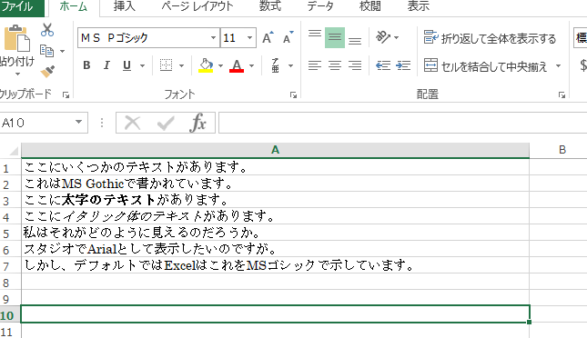
Source filename: MS Gothic as default test.xlsx
Japanese OS has the default font as “MS Pゴシック” or MS P Gothic

Slide 2
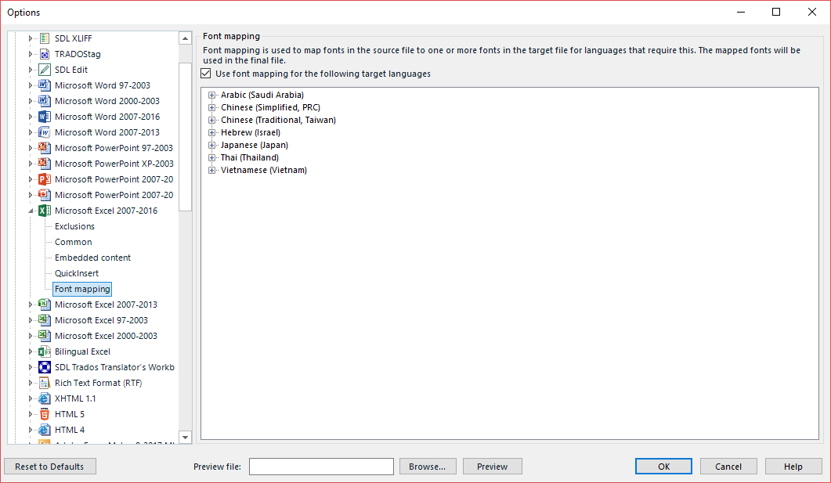
These are my untouched, default font mapping settings for the Microsoft Excel 2007-2016, which is set above other excel forms

Slide 3
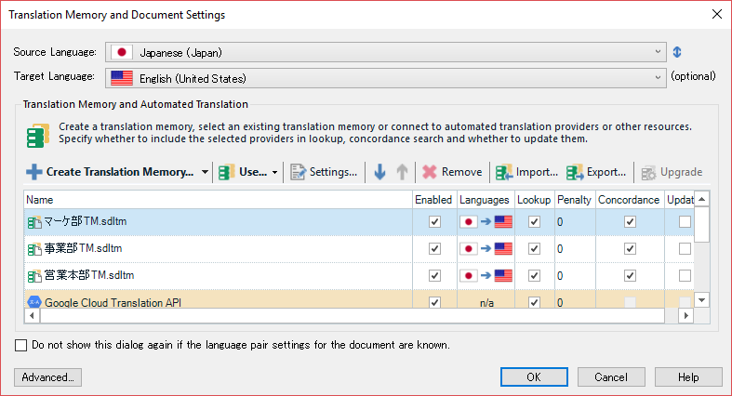
Each time I start an new “translate single document” project, my initial settings look like this.

Slide 4
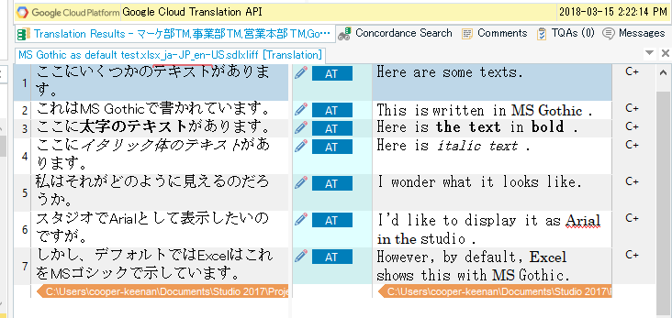
I pre-translate with MT and get English text written in MS Gothic. As expected really because I haven’t touched the font mapping settings.

Slide 5
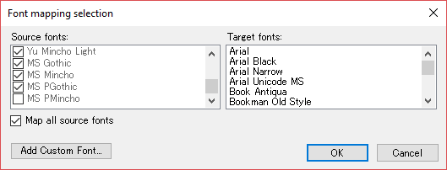
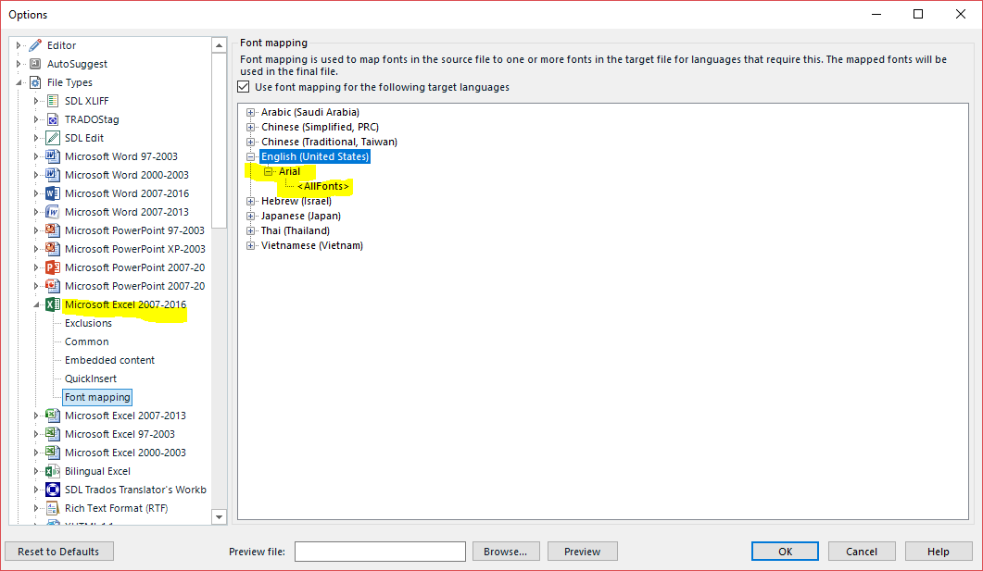
I close the project, go to font mapping, add English United States (as it is the target language), select map all source fonts, and click Arial as the Target font. Resulting in what is seen below.
Curious that MS PMincho can’t be selected though.

Slide 6
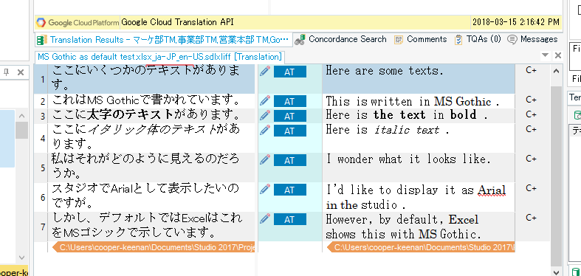
But, starting a new project (not reopening the previous project) still results in English text written in MS Gothic

Slide 7
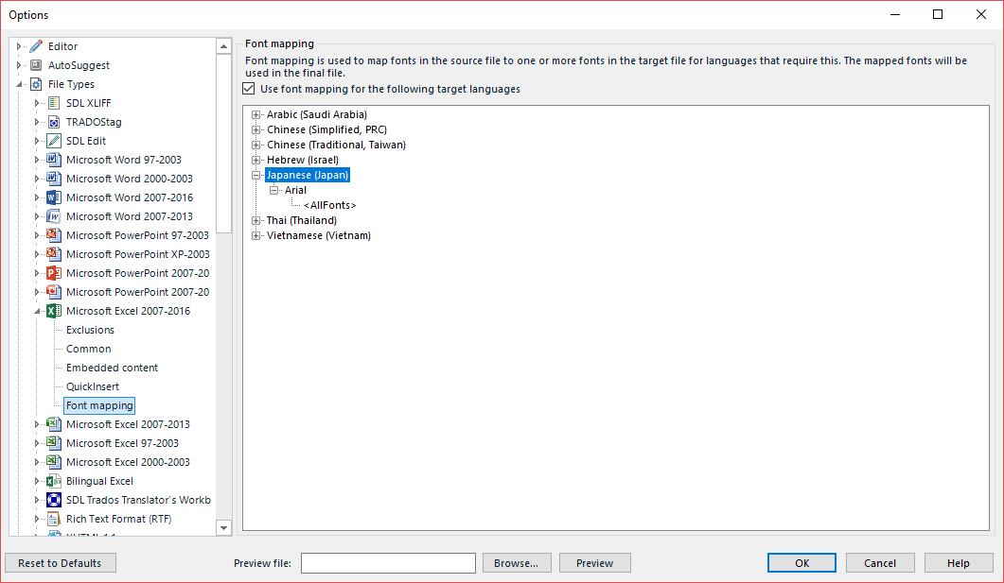
I close the project, go back to mapping, remove English, and add a font to Japanese in a similar fashion as before (select all source fonts, target: arial) just in case I was misunderstood what “use font mapping for the following target language”. Japanese is the source language though.

Slide 8
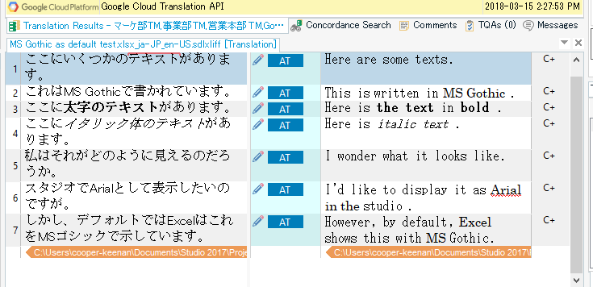
But, starting a new project (not reopening the previous project) still results in English text written in MS Gothic

Slide 9
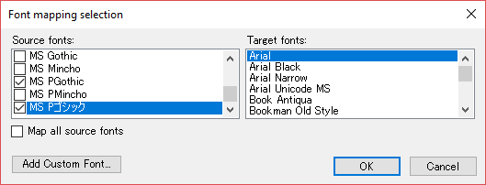
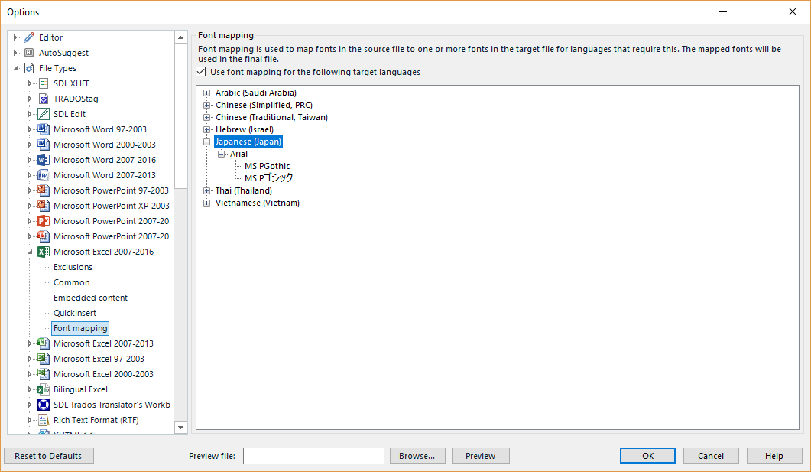
Back to font mapping, I tried pin pointing which font I wanted mapping. Which was, in English MS P Gothic, or in Japanese, which I added as a custom font, MS Pゴシック. Just in case

Slide 10
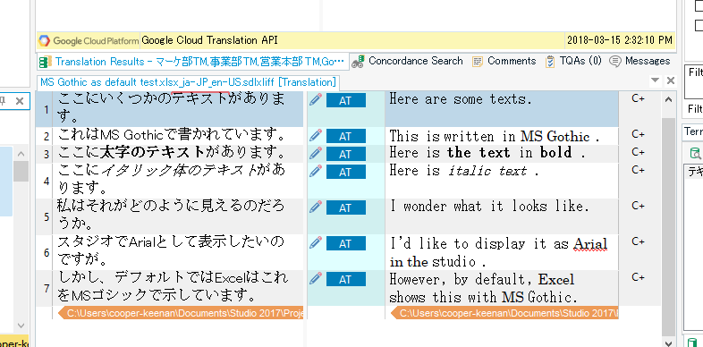
But no change. Please tell me what I’m doing wrong. Or at least, what is the proper application of font mapping?
Eventually, I’d like this setting to be for all MS Office files as Arial is our default English script.

